Slide 1



Week 3 and 4 Summary
ECE 499 Adam Dulay

Slide 2
Architecture Design #1
16-bits
Data Bus
Control Logic
A
B
16-bits
C
D
Memory
E
Inst. Mem
6 General Purpose Registers
Stack Pointer and Program Counter are registers with additional functionality
Memory Divided into Inst. Mem and RAM as per von Neumann
Linked together by a common data bus
F
SP
16-bits
RAM
Zero
16-bits
16-bits
16-bits
16-bits
+
PC
16-bits
16-bits
16-bits

Slide 3
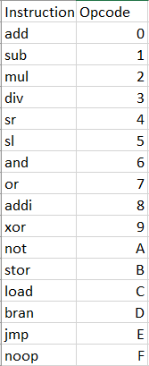
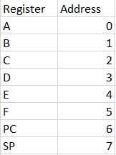
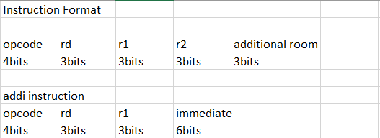
Instruction Set and Register Addresses
Looked at many different ISAs and found the most common instructions
3 bit register addresses
Additional bits at the end of some instructions for added instructions
Supports 6bit immediates

Slide 4
Questions?

